Slide 1
Team 35
Kainos: Intensive Care Support

Slide 2
Outline
Team roles:
Team roles allocation and task division
Proposed approach:
Develop procedure, languages and platform
Technical analysis:
Virtual Assistant, Responsiveness, Virtual Development and Search Engines
Team skills:
Our strengths, relevant skills and experiences
Summary

Slide 3
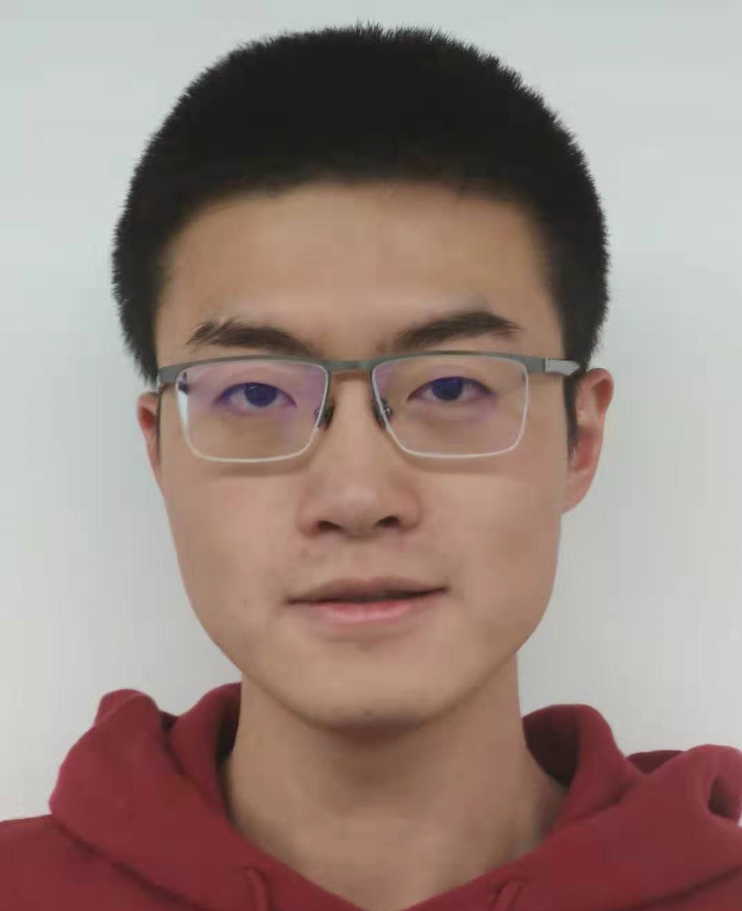
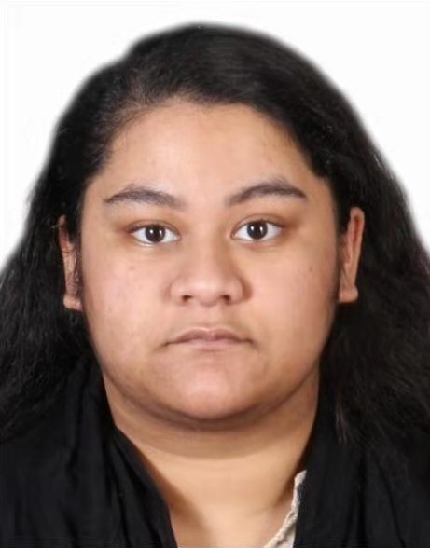
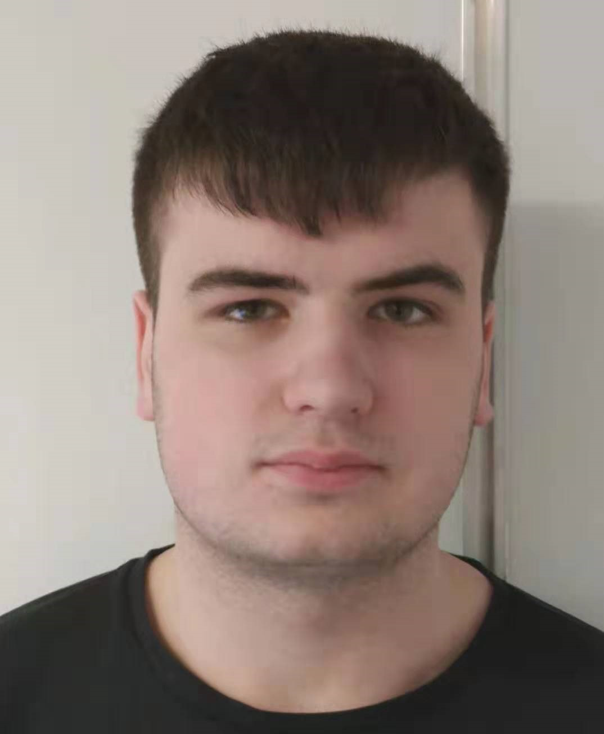
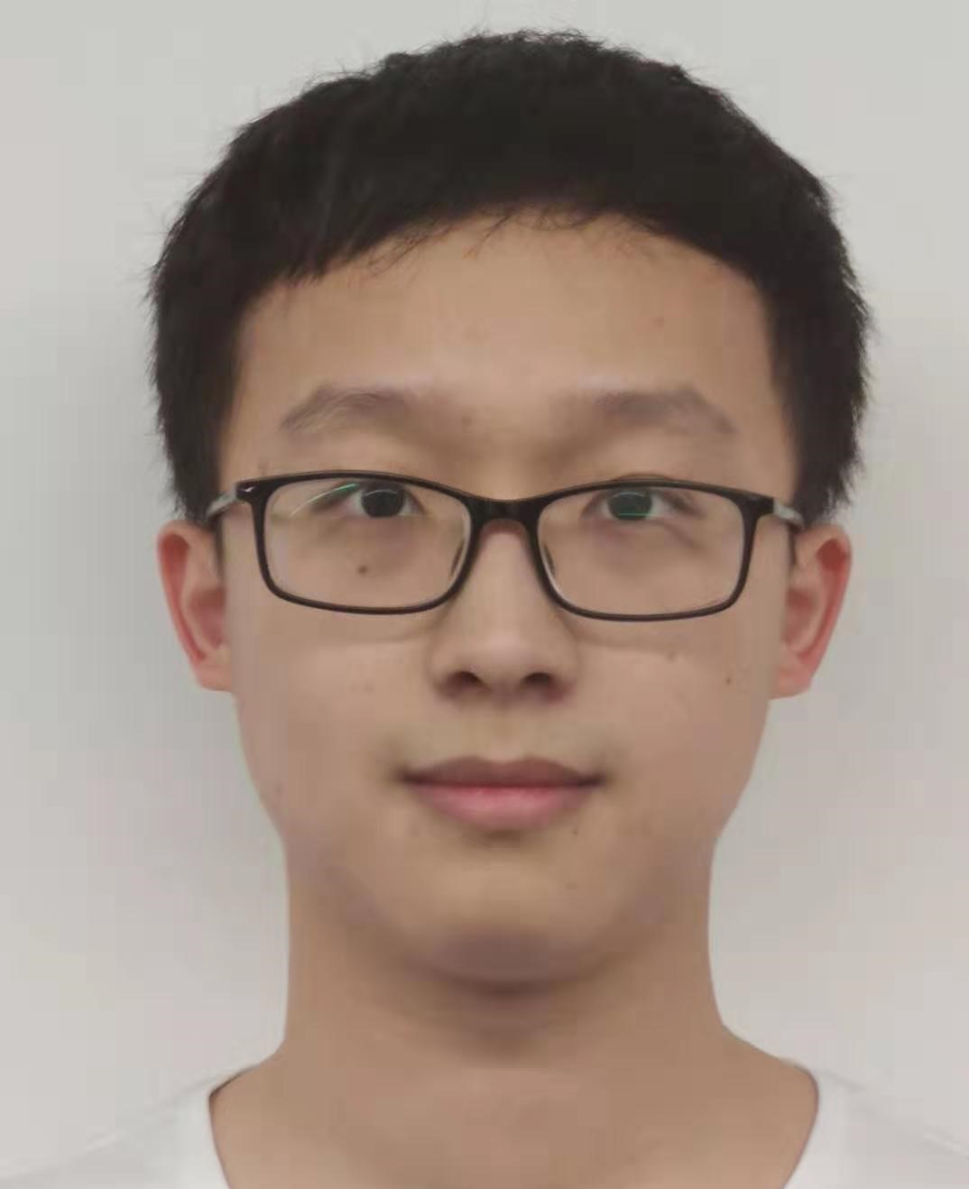
Team roles
Kejia Wu
Team leader
Main website structure
Tasnuva Tajin
Developing visual development platforms
Nicole Milinship
Team administrator
Main website structure
Liam Orrill
Visual development platform
Gurjyot Kaur
Git-master
Website design
Xuanhao Li
Testing and research

Slide 4



Proposed approach
Three main stages
Main structure of website (Agile methodology)
Virtual development platform
Virtual assistant (Dialogflow)
Languages and platforms
JavaScript (proposed to use REACT)
PHP
MySQL and SQL
Windows (test on IOS devices)
Virtual development platform
Information webpage
HTML
Page description languages
HTML5
CSS3 (@media)

Slide 5


Technical analysis
Virtual Assistant:
Map System
Front-end chat for queries
Server and backend
Matching
Database
Responsiveness
JavaScript listeners
Flexible Layout
CSS
Media queries
Virtual Web Development
Using JavaScript to manipulate HTML
Generate new website with format but no content
Administrator only has to add content
Good for non-technical users
Security & Search Engine:
Prevent SQL insertion
Prevent script insertion
2 search methods
Check if page already exists

Slide 6
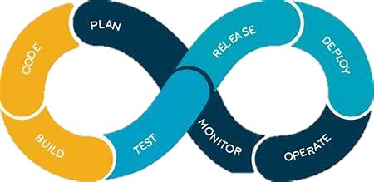
Team skills
Website development
Everyone has used PHP, JavaScript, SQL
Movie database
Hotel management system
Mobile web application development experience
Teamwork skills
Tasnuva works in IT Service
Liam joined the ice hockey team
Kejia worked in business company
Project management skills
Strong experience in agile
Knowledge in DevOps

Slide 7
Summary
We proposed to build this project in 3 stages
Gain great amount of experience in website development
A clear implementation strategy has been worked out already
Researched in visual website editor developing and non-technical UX
Have good understanding of DevOps and agile development method
Thank you for listening
Any questions?

